Slide 1



Cloud Engineering
General concepts

Slide 2
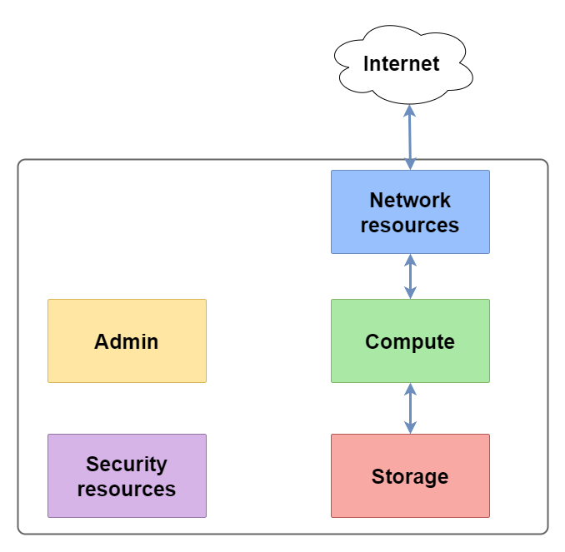
History, vocabULARY, CONTEXT
In 2002, launch of amazon.com. It tried to solve the problem of only using 10% of its capacity – dataversity.net
Main axes:
Objectives of the course
Understanding of the concepts
Culture about the main providers
Actual practice with one provider
Not an in-depth course this requires months of practice and training

Slide 3




Cloud providers we will talk about

Slide 4
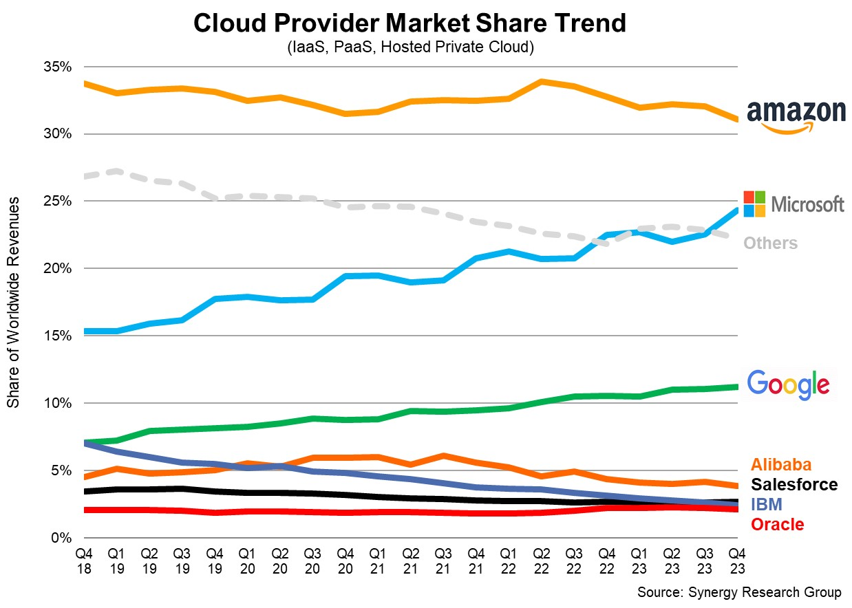
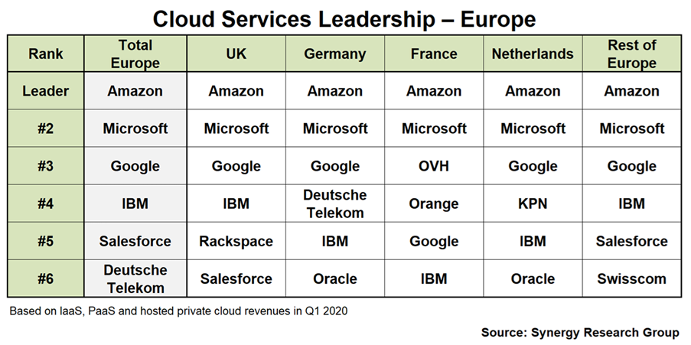
Market shares
Worldwide, Q2 2024
Europe, Q1 2020

Slide 5

Traditional approach: on-premise
Compute power = some server racks in a « servers room »
Typical number of servers: 10
Easy to maintain by the small team itself or by the hardware provider
Enough for a limited number of customers and a low criticity application
Don’t forget to lock the server room and keep a separate backup

Slide 6
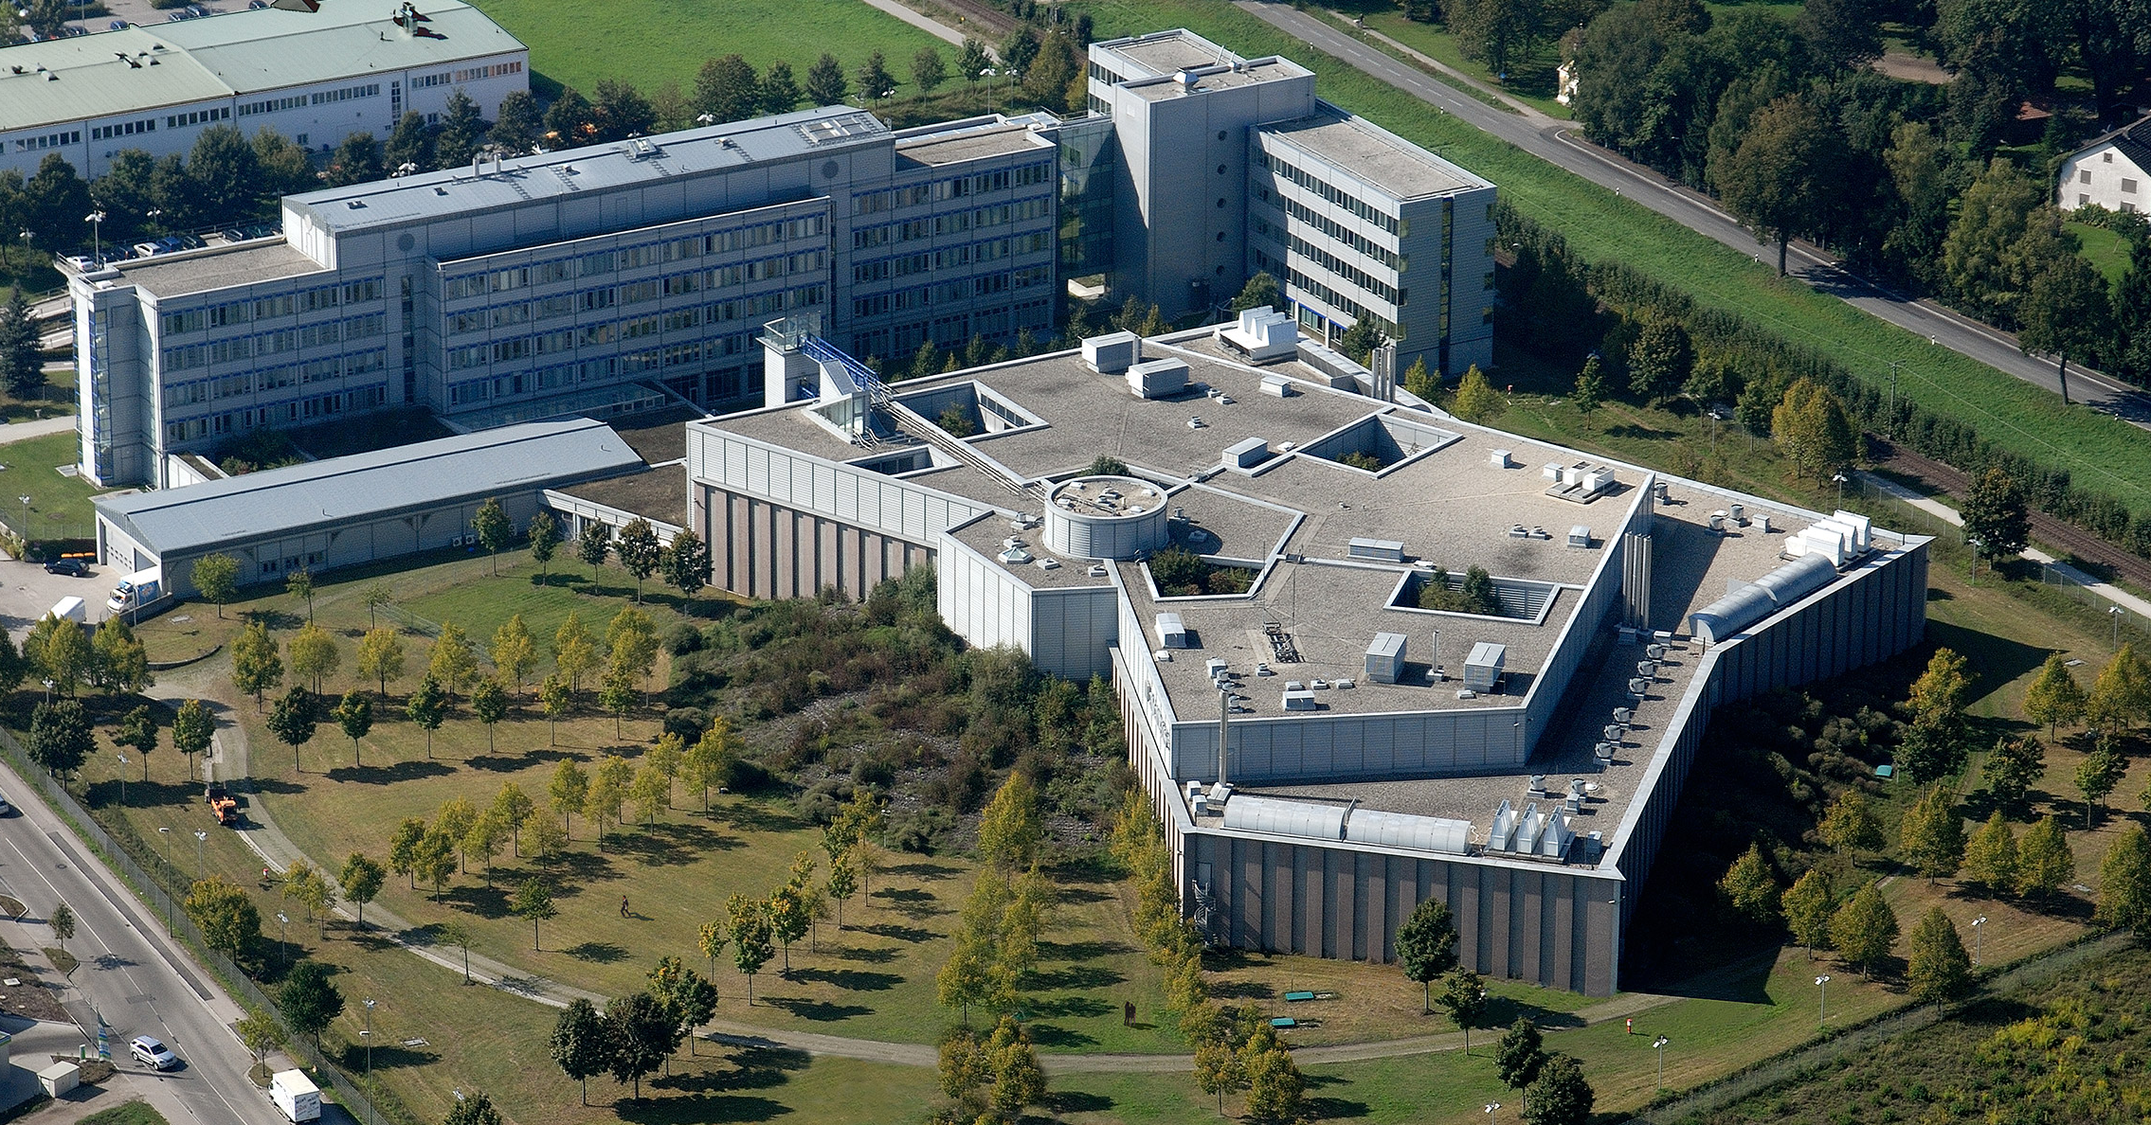
Traditional approach: OWN datacenter
Compute power = a dedicated hangar with many server racks
Typical number of servers: 1000
Typical electrical consumption: 2 MW
Complex facility to maintain
Need space, secondary power generator, cooling
Specific employees
No geographic separation (fire, earthquake, …)
Amadeus own datacenter near Munich
Source https://dgtlinfra.com/data-center-power

Slide 7

Cloud approach: rent the compute & storage power
PROS
CAPEX => OPEX: less risk, need less cash to start, can pivot
De-facto standard platforms on the market (2024)
AWS 31%
Azure 25%
Reduce complexity, focus on IT / App dev
AWS has 200+ services (including Quantum Computing)
Spread the solution around the globe
Close to customer to reduce the lag
Spread around the globe for resilience & disaster recovery
Alibaba datacenter
Source https://www.statista.com

Slide 8
Cloud approach: rent the compute & storage power
CONS
Control of the access the cloud is another company’s PC in another country➡️ region selection
Quality of Service how to trust the provider ➡️ SLA commitment
Risk of cost too high how to not overspend ➡️ Finops practice
Complexity, understanding how to master all the services and interactions➡️ trainings
Alibaba datacenter
Source https://www.statista.com/chart/18819/worldwide-market-share-of-leading-cloud-infrastructure-service-providers

Slide 9
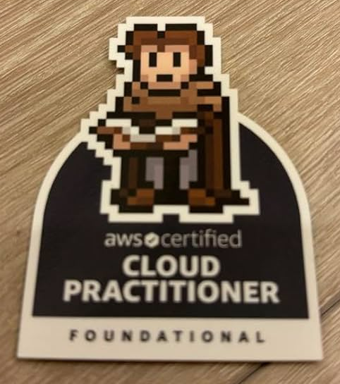
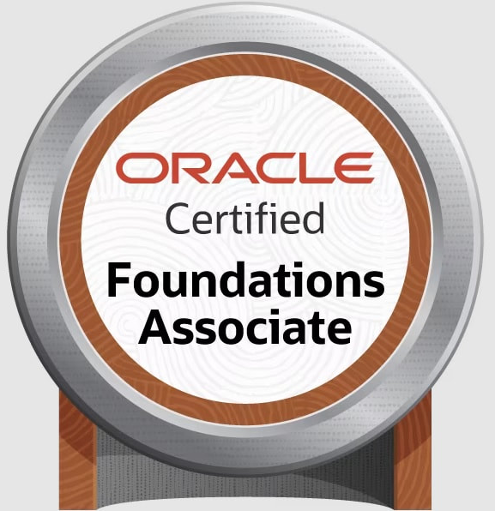
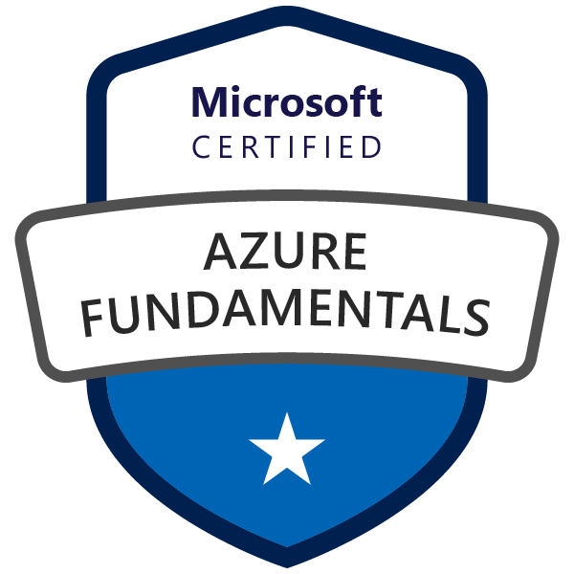
Trainings & sponsorship
Cloud providers can provide
100 – 1000 € of credits to startups
free cloud architect advise
Estia has a partnership with https://academy.oracle.com
Cloud engineering courses for oracle cloud and Database, AI oriented courses
300€ of credits for students

Slide 10
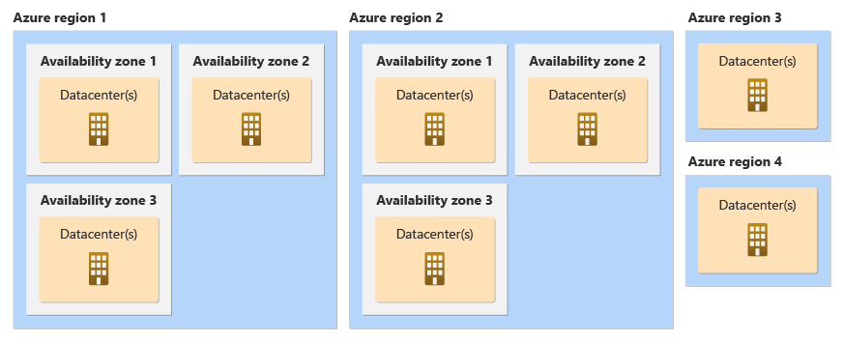
Organisation of resources in the cloud
Organisation by geographic zone
A datacenter is a single building with redunded power supply
An availability zone (AZ) is a group of datacenters located close to each other, low latency
AZs are physically far of each other to ensure resilience to natural disasters
Regions are geographical areas with their own laws (data privacy)
A region is comprised of AZs
Source: Azure Learn

Slide 11
Organisation of resources in the cloud
Organisation by geographic zone
Users choose the region according to their concerns about:
data safety and sovereignty
latency (stay close to the customers)
service availability (they may be only usable in some regions)
cost
Users can create resources in differents AZs to guarantee high avalability thanks to fault tolerance:
if there is a disaster in an AZ, the others should not be concerned
Source: Azure Learn

Slide 12
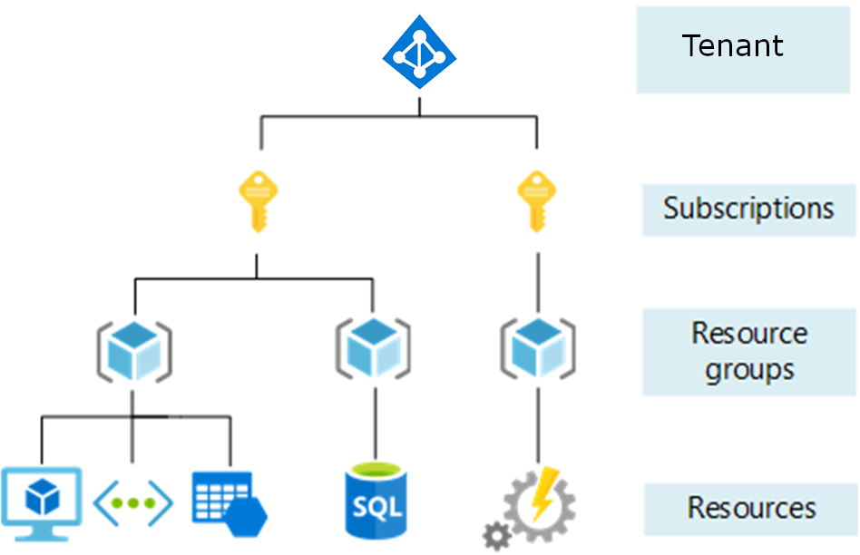
Organisation of resources in the cloud
Organisation by logical grouping
AWS Accounts / Azure Subscription is attached to a person/orga with a credit card being charged for all the resources
A Resource Groups (RG) is a logical grouping of resources working closely together
Tagging is a way to add some key:value flags to a resource or a whole RG, can be inherited by the linked resources
Many subscriptions can be managed in the same Azure Tenant / AWS Organisation
Source: Azure Learn

Slide 13
Organisation of resources in the cloud
Organisation by logical grouping
New users get 1 tenant and 1 subscription
You can get 1 subscription per environment for clear billing: dev, qa, prod
Resource groups can be used to gather the services associated to each apps
Multi-tenant = architecture where multiple customers (tenants) use the same resources but isolated data (B2B usecase)
Source: Azure Learn

Slide 14
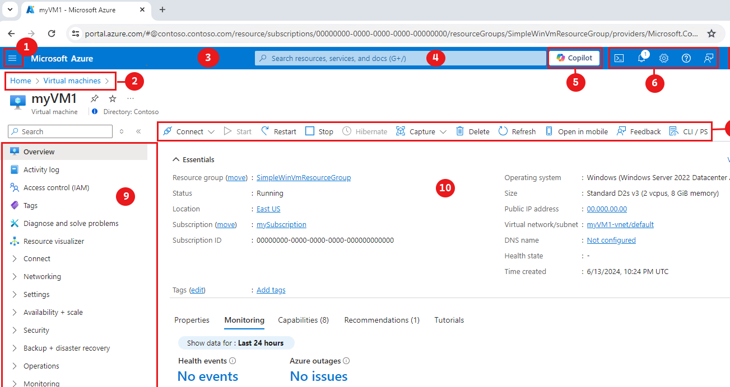
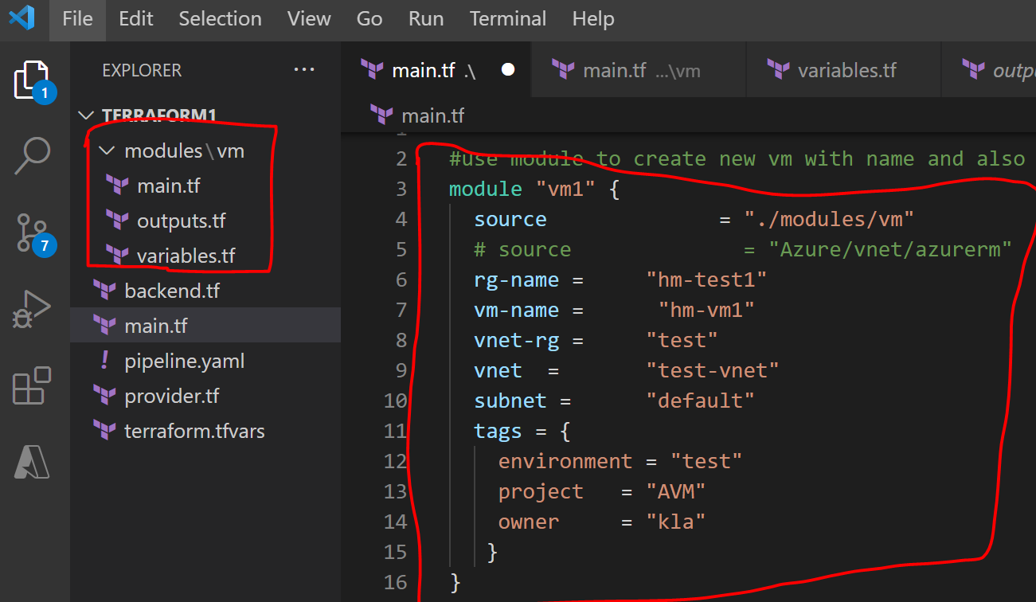
Ways of developping in the cloud
the web UI (aka the console, the portal)
the API (HTTP)
the CLI ➡️ example for AWS
the CLI within a terminal in the web UI (Cloud Shells)
the SDK (in the code) ➡️ example for AWS
Infrastructure As Code tools (Terraform, Pulumi, …)

Slide 15
Live demo
✨ A tour on the Oracle cloud web UI

